Slide 1
Manhattan distance for Semantic Similarity Analysis
By Your Name

Slide 2
Initial Thought
Instead of initializing the Siamese networks on our test data(500 questions combined with two answers for each) to directly calculate distance between query and answer, we decide to pretrain the Siamese Manhattan LSTM with SICK data which contains 9927 sentence pairs with a 5,000/4,927 training/test spliti( Each pair is annotated with a relatedness label ∈ [1, 5] corresponding to the average relatedness judged by 10 different individuals).
Then we would use our Siamese Manhattan LSTM trained from step 1 as our classifier to calculate the Manhattan distance between each query with their corresponding answer.
We would preprocess our data based on cause&effect model, which means we would combine question and answer according to the model as our new data format, then we compare the two options in one query:
Exp(Condition = cause, data1 = query1 + answer1, data2 = query1 + answer 2
Condition = effect, data1 = answer1 + query1, data2 = answer2 + query2)

Slide 3
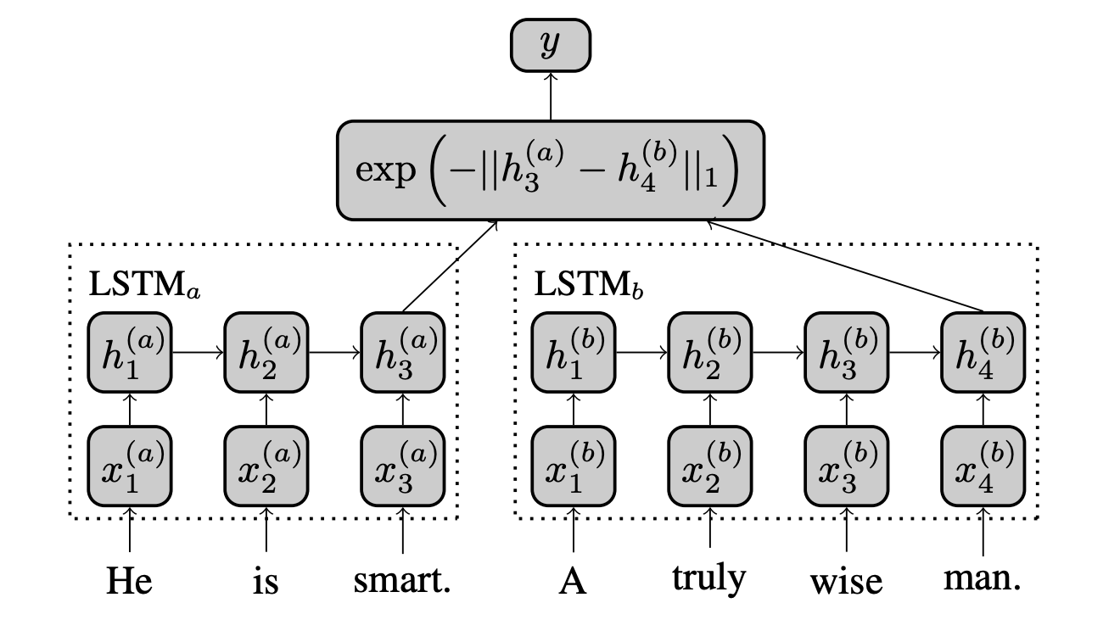
What is Manhattan LSTM
Manhattan LSTM models has two networks LSTMleft and LSTMright which process one of the sentences in a given pair independently.
Siamese LSTM, a version of Manhattan LSTM where both LSTMleft and LSTMright have same tied weights such that LSTMleft = LSTMright.
The model uses an LSTM to read in word-vectors representing each input sentence and employs its final hidden state as a vector representation for each sentence. Subsequently, the similarity between these representations is used as a predictor of semantic similarity

Slide 4
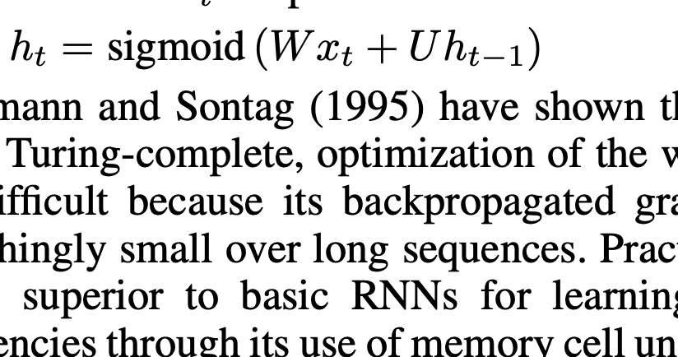
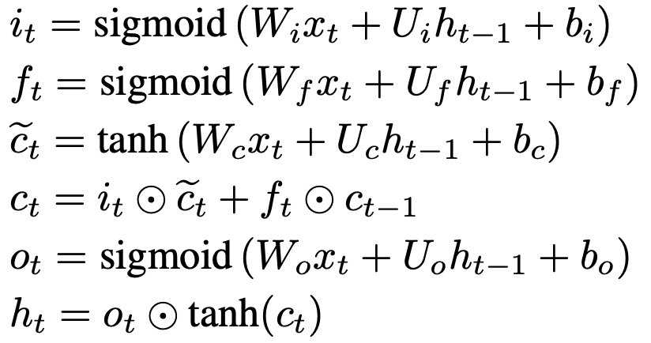
How it works
The LSTM learns a mapping from the space of variable length sequences of din-dimensional(Max length of sentences) vectors into R^embedding-dimension(embedding matrix length)
Each sentence (represented as a sequence of word vectors) x1,...,xT , is passed to the LSTM, which updates its hidden state at each sequence-index via equations:
Note: x(sequence data of scentence), W, U(weight matrix), t(# of hidden layer),

Slide 5
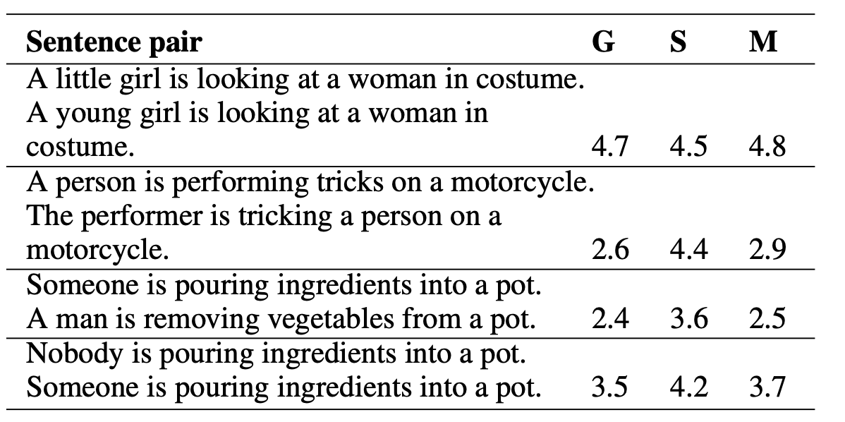
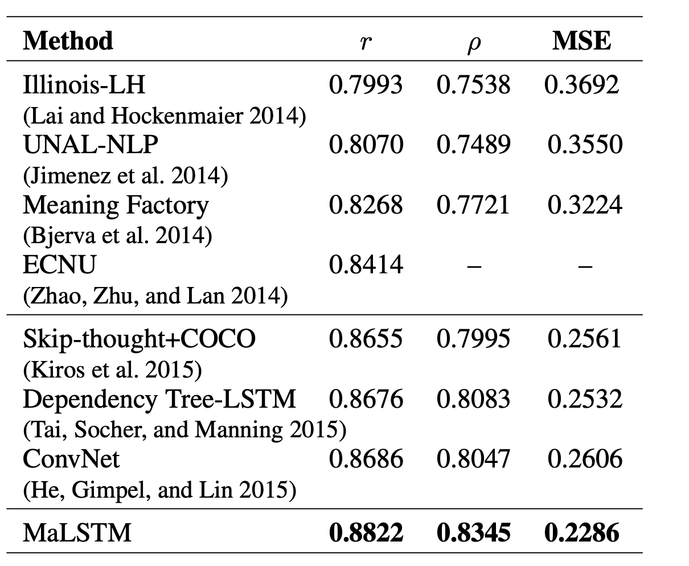
How well it works
Note: Example sentence pairs from the SICK test data. G denotes ground truth relatedness ∈ [1, 5], S = skip-thought predictions, and M = MaLSTM predictions. R is Pearson correlation (r), p is Spearman’s p.

Slide 6
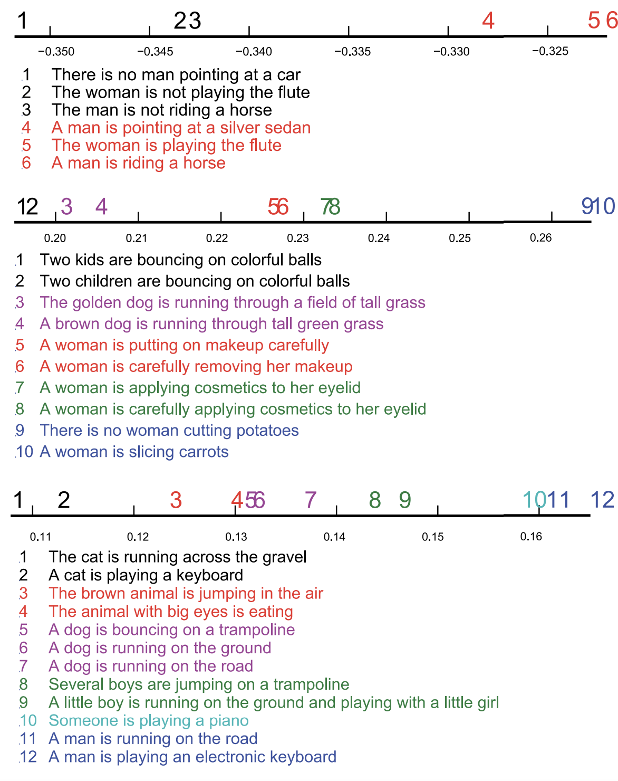
Implementation thought
Since our data contains ‘ , ’ special symbol if we combine question and answer together, we need to know how to deal with special symbol in order to not add unnecessary bias.
After plotting sentences into similarity axis, what would be the optimal classifier to correctly the organize the result.
The Loss can be conclude into three part [loss_pretrained model, loss_on_similarity_calculation, loss_on_classification], what would be the best trade off for our loss optimization?

Slide 7
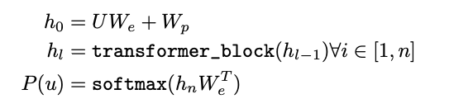
Pre-trained Word Representation Model Approach
To design our own pre-trained word representation model, we follow the unsupervised pre-training
architecture:
Where U is the context vector of tokens and n is the number of layers.
We is the token embedding matrix, and Wp is the position embedding matrix.

Slide 8
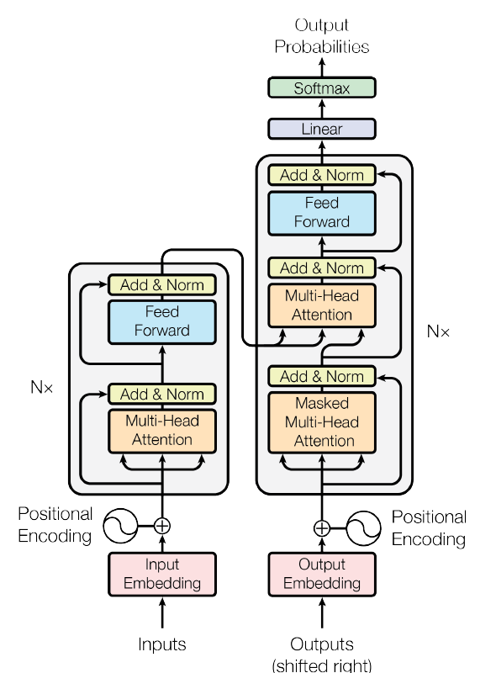
Design of the transformer block
The transformer model has an encoder-decoder structure. The Transformer follows this overall architecture using
stacked self-attention and point-wise, fully connected layers for both the encoder and decoder, shown in the left
and right halves of the Figure above, respectively.

Slide 9
Encoder: Each layer has two sub-layers. The first is a multi-head self-attention mechanism, and the second is a position-wise fully connected feed-forward network. Each of the two sub-layers is followed by normalization layer.
Decoder: In addition to the two sub-layers in each encoder layer, the decoder inserts a third sub-layer, which performs multi-head attention over the output of the encoder stack. The self-attention sub-layer is modified in the decoder stack to prevent positions from attending to subsequent positions. This masking, combined with fact that the output embeddings are offset by one position, ensures that the predictions for position i can depend only on the known outputs at positions less than i.

